Slide 1
Kubernetes
Notes:
1

Slide 2
Custom Resource Definition
Allows you to create your own API objects and define your own kind just like Pod, Deployment, ReplicaSet, etc.
Allows you to extend Kubernetes capabilities by adding any kind of API object useful for your application

Slide 3
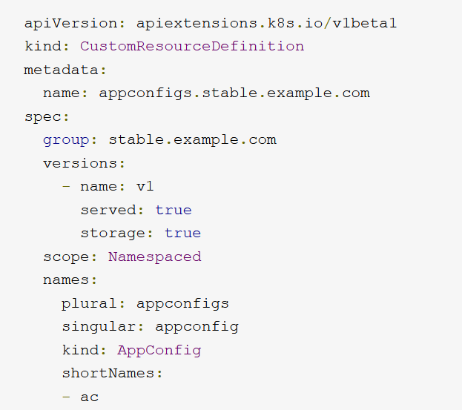
Custom Resource Definition
metadata field define what the name of the resource
Spec group - What the group name will be.
Spec version helps us define the version
Kind name name and the short name

Slide 4
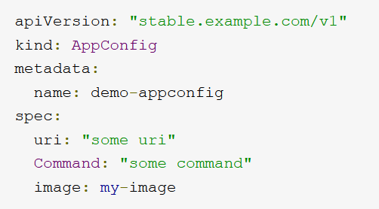
Custom Resource Definition

Slide 5
Operators
What is Kubernetes Operator ?
Why Operators are used?
When should you use them ?

Slide 6

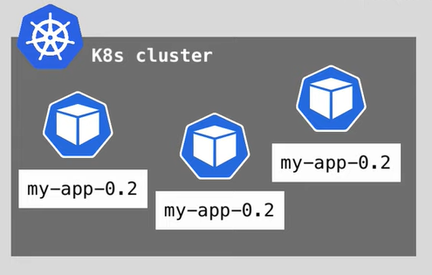
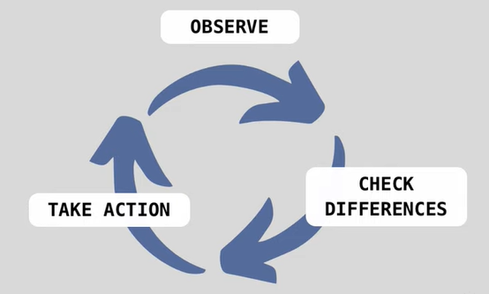
StatelessApplications

Slide 7
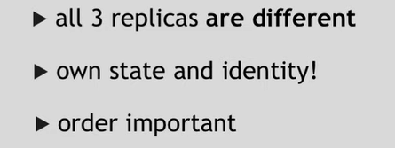
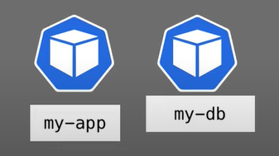
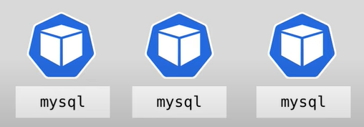
Stateful Applications

Slide 8
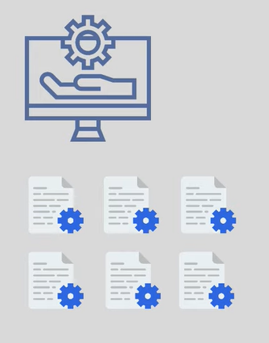
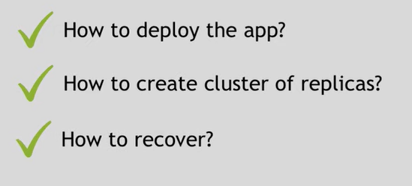
Operator

Slide 9


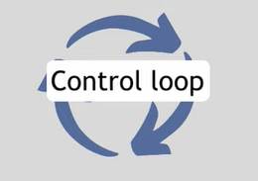


How does Operator work?

Slide 10
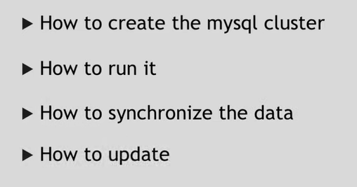
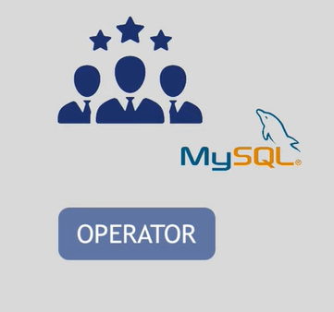
Operators

Slide 11
Kubernetes Cluster – Control Plane
Etcd - Two-Four CPU cores are enough and disk I/O will be far more critical; therefore, making sure the fastest disks available are used.
Small etcd cluster serving under 200 Kubernetes nodes will be three servers with two cores each, 8GB of RAM, 20GB of disk space per node (greater than 3000 concurrent IOPS)
API Server - Four CPU cores and 16GB of memory
On small clusters with under 100 nodes, the control plane will fit into the unused capacity from the etcd cluster as long as the nodes have
Each instance can only handle a set number of requests at a time which defaults to 400.

Slide 12
Kubernetes Cluster – Data Plane
Worker Nodes :-
Assume the average pod will have a requested memory of 256Mb.
3000 pods will require 750GB of total memory across all the nodes, plus the 1 GB of base per-node memory already required (kubelet, plus the three DaemonSets listed above).
On AKS, each of the 112 nodes would need 8GB of RAM at the absolute minimum. But GKE or OpenShift (with 100 pods per node as the default limit) would have 31 nodes with 26GB of RAM minimum.

Slide 13
Openshift
For production environments, the following recommendations apply:
Master Hosts
1 CPU core and 1.5 GB of memory for each 1000 pods.
Recommended size of a master host in an OpenShift Container Platform cluster of 2000 pods
Minimum requirements of 2 CPU cores and 16 GB of RAM, plus 2 CPU cores and 3 GB of RAM,
Total 4 CPU cores and 19 GB of RAM.

Slide 14
Certificate Rotation
etcd
kubelet
kube-apiserver
kube-proxy
kube-scheduler
kube-controller-manager

Slide 15
CKA
https://github.com/dgkanatsios/CKAD-exercises
https://github.com/twajr/ckad-prep-notes
https://github.com/walidshaari/Kubernetes-Certified-Administrator
https://medium.com/bb-tutorials-and-thoughts/practice-enough-with-these-questions-for-the-ckad-exam-2f42d1228552

Slide 16
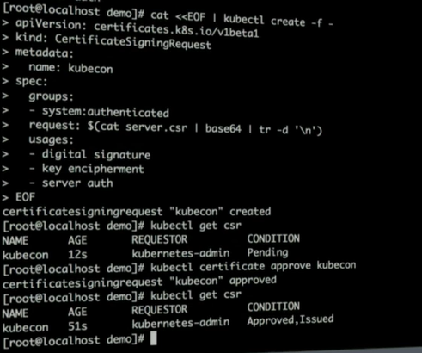
Certificate Signing Request

Slide 17
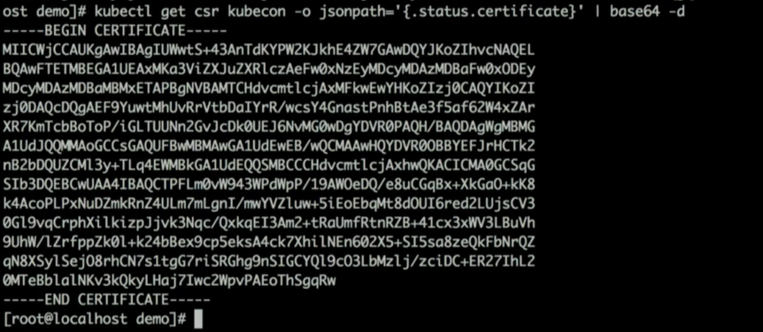
Certificate Signing Request

